Slide 1
AI Credit Card Fraud Detection Technical Capstone Presentation
TECHINICAL Presentation
Orlando Pedro Z. Alparce
AIM Post Graduate Diploma in Artificial Intelligence and Machine Learning

Slide 2
OBJECTIVES & PROBLEM FRAMING
BUSINESS CHALLENGE
Fraudulent transactions impose substantial financial losses on institutions, but also introduce critical customer friction if genuine payments are flagged
Imbalance Constraints: True fraud cases represent a microscopic 0.17% of overall activity, meaning naive models can achieve high accuracy by simply guessing "non-fraud".
DATA SCIENCE PROBLEM
The machine learning objective is to train a model capable of recognizing the elusive, highly-skewed signatures of fraudulent entities without overfitting.
Primary Goal: Build a high-precision framework targeting specific key performance indicators: PRAUC, Recall, Precision, and ROC-AUC.

Slide 3
KAGGLE DATASET SUMMARY
TOTAL OBSERVATIONS
Variable | Type | Description
Time | Float | Seconds elapsed since first recorded transaction in dataset
Amount | Float | Transaction value in fiat currency units
V1 – V28 | Float | Anonymized PCA components safeguarding customer privacy
Class | Integer | Target Variable (0 = Non-Fraud, 1 = Fraud)
284,807 Transactions
IDENTIFIED FRAUD CASES
492 Cases (0.173%)
DATA HYGIENE
0 missing values detected. 1,081 duplicates isolated and removed during standard ingestion preprocessing.

Slide 4
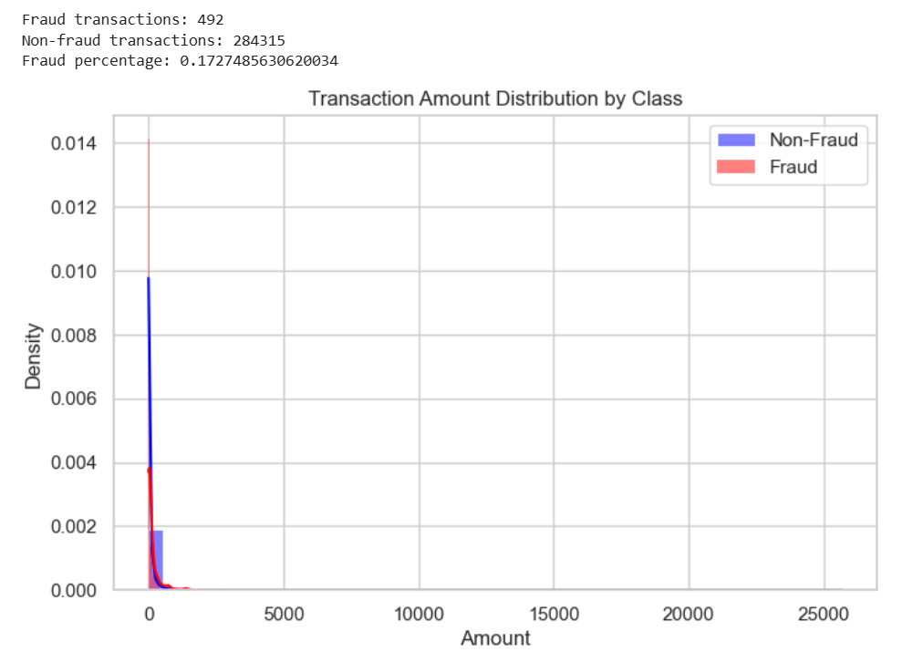
EXPLORATORY DATA ANALYSIS
Key Insights from EDA
Extreme Class Imbalance: Fraud accounts for only 492 cases compared to 284,315 non-fraud.
Amount Skewness: Transaction values are heavily right-skewed, requiring logarithmic transformation or feature scaling.
Feature Interaction: Anonymized PCA components showcase complex non-linear separability.

Slide 5

Feature Engineering Strategy
Derived Variables
High-Value Flags
Random Forest Selection
Introduced Log Amount scaling using mathematical transformations to normalize skewed dollar values:
Created categorical heuristics signalling high transaction tiers:
Applied tree-based model features thresholder by median model support to reduce dimensionality.

Slide 6
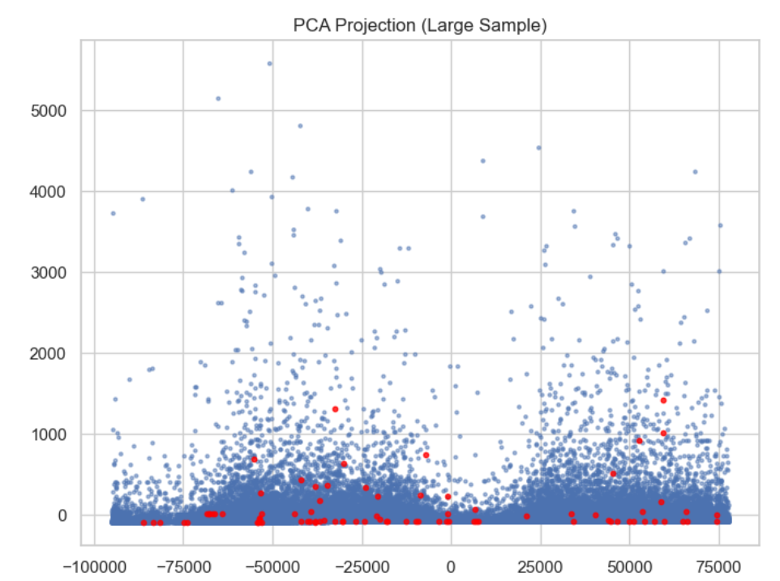
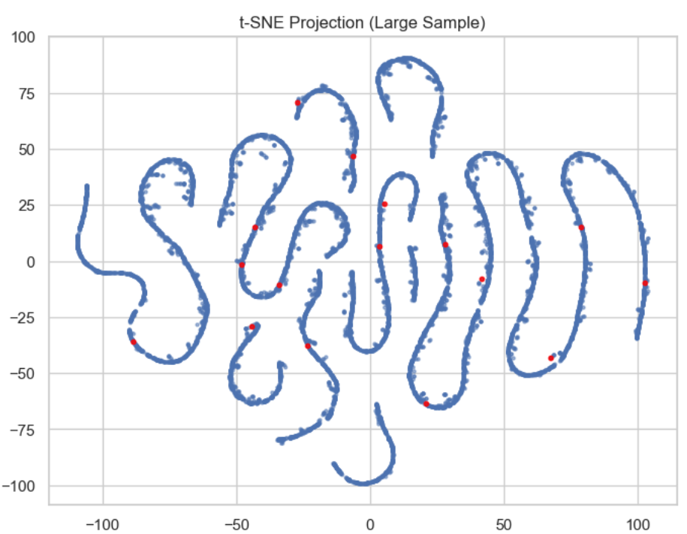
DIMENSIONALITY REDUCTION
Mapping Component Spaces
PCA Projection: Yields rapid linear separation thresholds, isolating dense central non-fraud zones from peripheral fraud clusters.
t-SNE Projection: Maps non-linear manifold spaces. This visual separation informs the reliance on robust tree ensemble pipelines.

Slide 7
MACHINE LEARNING PIPELINE
Stratified Split
80-20 partition maintaining exact minority class balance across test frameworks.
SMOTE Ingestion
Synthetically balanced oversampling applied solely inside training splits to prevent leakage.
Feature Selection
Standardized scaling applied to Time/Amount; SelectFromModel selects top features.
Model Search
Logistic Regression, Random Forest, and XGBoost hyperparameter tuned via RandomizedSearchCV.

Slide 8
MODEL PERFORMANCE COMPARISON
Classifier Engine | Precision | Recall | F1 Score | False Positives | False Negatives | ROC-AUC | PR-AUC
Logistic Regression | 0.052 | 0.918 | 0.099 | 1,630 | 8 | 0.972 | 0.733
Random Forest (Selected) | 0.810 | 0.827 | 0.818 | 19 | 17 | 0.970 | 0.869
XGBoost Classifier | 0.237 | 0.888 | 0.374 | 280 | 11 | 0.977 | 0.854
Decision Framework: Despite having a lower absolute recall than Logistic Regression, the Random Forest was prioritized due to its extremely low operational False Positives (19 vs 1,630). This drastically minimizes customer service friction while preserving strong general performance.

Slide 9
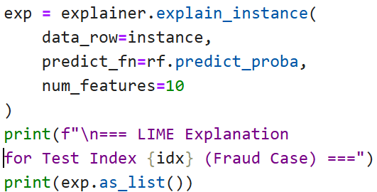
EXPLAINABILITY & INTERPRETABILITY
Permutation Importance
PDP & ICE Diagnostics
Local Interpretability (LIME)
Identifies global model drivers. The top diagnostic features in fraud identification mapped out consistently as:
V14, V10, V12, V17, Log_Amount
Partial Dependence Plots (PDP) reveal non-linear
paths. A steep probability threshold change was
observed at the boundaries of feature V14.
Generates local sparse explanations to trace exact
model decisions for human review boards.

Slide 10
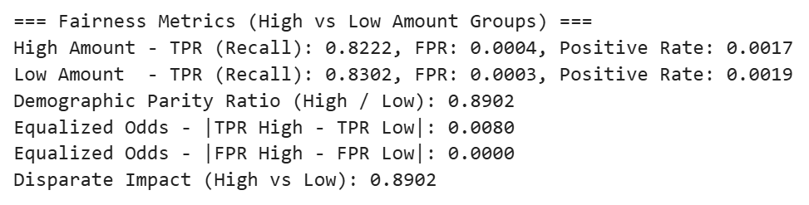
ETHICAL AI & FAIRNESS AUDIT
Fairness Summary
The auditing process evaluated algorithmic disparity across transaction value groups.
Verdict:
Disparities in target metrics represent statistically negligible differences. The trained classifier maintains a fair, robust, and non-discriminatory outcome space across monetary sizes.

Slide 11
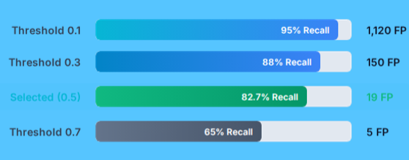
OPERATIONAL THRESHOLD TUNING
The Recall-FP Trade-off
lowering model thresholds scales up THE transaction recall successfully, but is held back by generating an unacceptable volume of false alarms.
Selected Decision Limit
An operational threshold of 0.5 was locked into balance transaction capture
limits against standard operational risk profiles.

Slide 12
KEY PROJECT ACHIEVEMENTS
0.8687
Precision-Recall AUC
Robust Model Selection
The Random Forest pipeline achieves superior predictive precision without subjecting cardholders to excessive false-alarm friction.
19
False Positives (of 56.8k)
ETHICS AND REGULATORY COMPLIANCE
Built-in fairness checks confirm zero class bias and high consistency across transaction amounts, ensuring clean operational audits.

